Slide 1
ZiRA models to ZiRA versie 1.2
(EN-versie)

Slide 2
The Nictiz interoperability model with the ZiRA concepts
Security
Laws and Regulations
Organizational Policy
Customer
Hospitals serve customers,
consist of business functions
Business Function
and provide services
Service
Care Process
that are supplied by one or more processes,
Process
and come about through one or more business activities,
Business Activity
Information
where information objects are edited and consulted,
Information Object
Application
Application Function
and use is made of application functions,
that are supplied by applications,
Application Component
IT-infrastructure
and are installed on an IT infrastructuur.
Infrastructuur

Slide 3
Metamodel
Customer
Service
Business Function
Information Domain
Business Process
Work Proces
Business Activity
Customer:
A person or organization that is served by a hospital.
Service:
A defined performance of a person or organization that meets a customer's needs.
Business function:
A collection of business activities that display mutual coherence in the required knowledge, skills, resources or required applications.
Business process:
Ordered series of work processes that are carried out within one organization with the aim of providing a (combination of) service (s) to a citizen, company or organization.
Work process:
An ordered series of process steps (business activities) carried out within one organizational unit within an organization with the aim of making a specific contribution (performance) to a service. (Can be a supporting process).
Business activity / Process step:
A task with the right size to be assigned to a specific person or role.
Information domain:
A set of business activities with a maximum coherence in the information produced and used by the activities.
Information object:
A unit of information that is relevant from a business perspective. Information can be used or created in one or more business activities.
Information Object
zib
zib:
Healthcare information building block. An information object can be related to 1 or more ZIBs.
Application function:
Related functionality offered by an application component. An application function offers support to one or more business activities.
Application component:
The actual software that delivers the application functionality.
Application Function
Application
component

Slide 4
Metamodel example
Customer:
Neurologist
Service: Additional Diagnostic Testing
Business Function:
Analysis of Body Fluids (Lab test)
Information Domain
Business Process: Manage Additional Diagnostic Testing
Work Process: Conduct Additional Diagnostic Testing
Business Activity:
Summarize Findings
Information Object:
Lab Report
+
zib
Application Function:
Lab File Creation
Application Component:
Lab Information Management System
+ Consists of 1 or more

Slide 5
Basic structure of the ZiRA reference models
Management
CONTROL
Research
Healthcare
Teaching
CORE
Enterprise Support
SUPPORT
General corporate structure
Basic hospital structure

Slide 6
Common structure of the ZiRA reference models
MANAGEMENT
HEALTHCARE
RESEARCH
TEACHING
Collaboration
Consultation
Treatment
Additional Diagnostic Testing
Care Support
ENTERPRISE SUPPORT
Common structure ZiRA models
Primary focus area ZiRA reference models

Slide 7
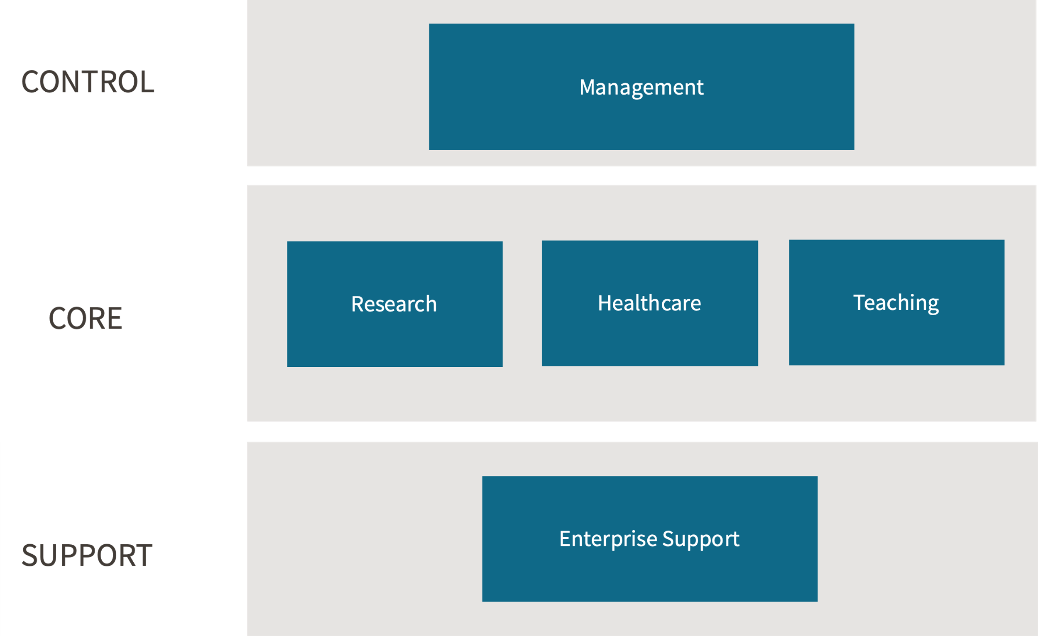
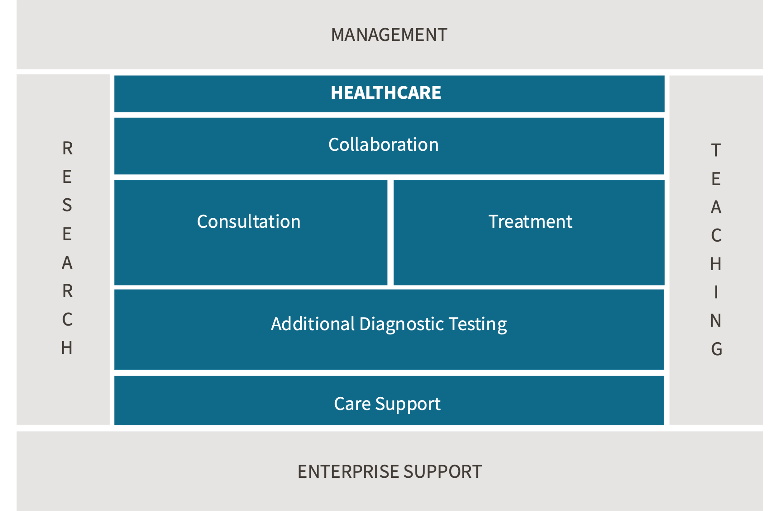
Basic (A) and Elaborated (B) Structure of ZiRA Reference Models
A
B
General corporate structure
Basic hospital structure
Common structure ZiRA models
Primary focus area ZiRA reference models

Slide 8
Business Function vs. Business Process
Business Function A
Business Function B
Customer
Business Process 1
Work Process
Work Process
Business
Activity
Business
Activity
Business
Activity
Service 1
Request
Business Process 2
Work Process
Work Process
Work Process
Business
Activity 2
Business
Activity 3
Business
Activity 4
Business
Activity 5
Service 2
Request
Business
Activity 1

Slide 9
Business model canvas
Strategic partners
Core activities
Value proposition
Customer relationships
Customer segment
• Primary care providers
• Secondary care providers
• Tertiary care providers
• Insurers
• Educational institutions
• Research institutions
• Suppliers
• Tenants
• Governmental institutions
• ...
• Diagnostics
• Treatment
• Consultation
• Information
• Education
• Research
• Case management
• ...
• Providing basic and acute hospital care
• Providing specialist care
• Supplying non-clinical healthcare services
• Facilitating collaboration
• Conducting scientific research
• Offering rental space
• Offering training facilities
• ...
• Counseling
• Accompaniment
• Facilitating selfcare
• Community integration
• ...
• Patients with care needs
• General practitioners
• Educational institutions
• Tenants
• Hospitals and laboratories
• Insurers
• ...
Staff and resources
Communication
• Medical and non-medical personnel
• Buildings and facilities
• Medical equipment / applications
• Data and information technology
• Infotainment
• Hospitality services
• Accreditations and Approvals
• ...
• Front desk
• (Poli) clinic
• Website & Portal
• On location (GP, home)
• Primary, secondary, tertiary providers
• Marketing and Publications
• ...
Cost structuur
Income structuur
• Salaries
• Medical equipment
• Buildings / facilities
• Utilities
• Staff training
• Licenses
• Outsourcing/ consultancy
• Uncompensated care
• ...
• Allocated budgets
• Insurance payments
• Subsidies & Grants
• Facility rental
• Scientific/pharmaceutical research
• Tuition
•...

Slide 10
Business Function Model
Management
Strategy and
Governance
Planning
and Control
Innovation
Quality
Management
Performance
Management
Accountability
Marketing
Research
Health Care
Teaching
Research Development
Collaboration
Participation
Referral
and Transfer
Curriculum
Development
Research Preparation
Consultation
Treatment
Teaching
Perfomance
Research Implementation
Diagnostics
Advice
Treatment Planning
Therapy
Nursing
Nursing Assistance
Surgery
Medication
Other
treatment
Research Publication
Additional Diagnostic Testing
Teaching Evaluation
Analysis of
Body Fluids
Imaging
Endoscopy
Value Generation
Microbiology and immunology
Biopsy
Measurement of Body Functions
Analysis of Genetic Material
Research Support
Care Support
Teaching Support
Payor and Provider Relations
Logistics
Billing
Enterprise Support
Property and Resource Management
Human Resource Management
Purchase and Goods Logistics
Financial Administration
Legal Support
Communication
and Information
Medical Technology
Hospitality
Safety and Environment
Knowledge Management
IT
Notes:
Figure 4.1: The ZiRA Business Function Model

Slide 11
Service Model
Management
Strategy & Governance
Planning & Control
Innovation
Quality management
Performance management
Accountability
Marketing
Core services
Research
Customer
Healthcare Delivery
Teaching
I need Care
(preventive, acute, urgent, elective, chronic)
I want to
know what is
wrong with me
I want to
have some
tests done
I want advice
I want to
be treated
HORA
Process model
HORA
Process model
Service
Determine
Need
for Care
Diagnostics
Additional
Diagnostic
Testing
Advice
Treatment
Plan
Treatment
Transfer
Enterprise Support
Property and Resource management
Human Resource Management
Purchase and Logistics
Financial
Administration
Legal Support
Communication
and information
Medical Technology
Hospitality
Safety and Environment
Knowledge
management
IT
Out of scope (not further elaborated)
General care request
Specific care request

Slide 12
Service Categories
Healthcare Delivery
(preventive, acute, urgent, elective, chronic)
Diagnostics
Additional Diagnostic Testing
Advice
Treatment
Research design
Laboratory
Other
Therapy
Other
Surgery
Pharmacy
Nursing
Imaging
Basic Care Giving

Slide 13
Process Model Level 1 Business Processes
Management processes
Determine Mission and Vision
Develop Strategy
Develop Policy
Implement Changes
Core Processes
RESEARCH
Deliver Healthcare
TEACHING
Diagnostic therapeutic cycle
Give
Advice
HORA
Process Model
HORA
Process Model
Determine
Care Needs
Diagnose
Establish
Treatment
Plan
Treatment
Transfer
Conduct Additional Diagnostic Testing
Supporting Processes
Real estate and
resource management
Staff and organization
Purchasing and
goods logistics
Financial
administration
Legal support
Communication
and information
Medical technology
Hospitality
Safety and environment
Knowledge management
ICT

Slide 14
Services and processes (Healthcare domain)
Determine Need
for Care
Determine care needs
Process referral
Determine
care needs
Plan contact
Diagnostics
Diagnose
Prepare contact
Receive patient
Collect additional
information
Assess information
Make diagnosis
Additional
Diagnostic Testing
Conduct Additional
Diagnostic Testing
Assess diagnostic
testing request
Plan diagnostic testing
Prepare
diagnostic testing
Conduct
diagnostic testing
Assess result
Report result
Advice
Advise
Assess advice request
Give advice
Treatment Plan
Establish
treatment plan
Determine
treatment plan
Request treatment
activity
Plan treatment
activity
Perform Treatment
Carry out other medical treatment
Perform operative treatment
Treatment
Treat
Prepare treatment
Conduct therapy
Evaluate treatment
Carry out drug therapy
Perform nursing care
Perform additional care
Transfer
Transfer
Determine transfer Policy
Transfer patient
Service
Business Process
Work Process

Slide 15
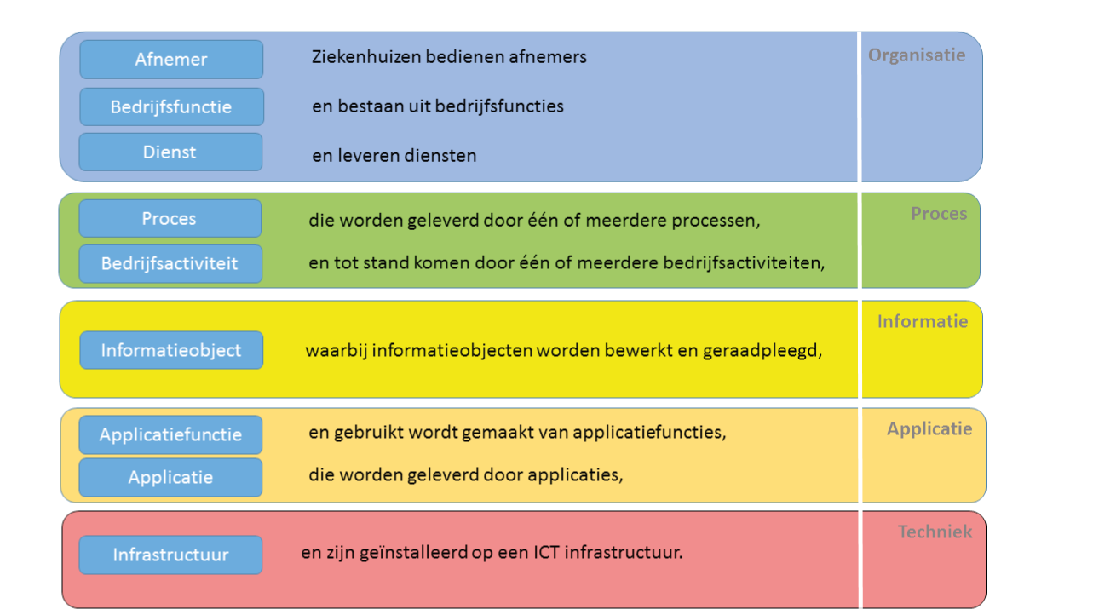
Healthcare services and processes - model
Composite service
Delivering care
(preventive, acute, urgent, elective, chronic)
Internal Service
Determine Need for Care
Diagnostics
Additional Diagnostic Testing
Advice
Treatment Plan
Therapy
Hand Over
Services
Business Process
Determine
care needs
Diagnose
Conduct
additional diagnostic testing
Advise
Establish
treatment plan
Treat
Transfer
Prepare investigation
Work Process
Assessing research request
Plan Investigations
Perform Research
Assessing result
Make Diagnosis
Reporting Result
Schedule Contact
Review Information
Give Advice
Transfer Patient
Prepare Contact
Process Reference
Patient Received
Determine Care Needs
Assess Advice Request
Determine Treatment Plan
Plans Treatment Activity
Evaluate Treatment
Prepare Treatment
Determine Transfer
Collect Additional Information
Request Treatment Activity
Perform Treatment

Slide 16
Information domain model
Management
Strategy and Governance
Planning
and Control
Innovation
Quality
Management
Performance
Management
Accountability
Marketing
Research
Healthcare
Teaching
Research Development
Collaboration
Curriculum Development
Participation
Referral and Transfer
Research Preparation
Consultation
Treatment
Teaching Performance
Research Performance
Diagnosis
Advice
Treatment Planning
Therapy
Nursing
Nursing Assistance
Surgery
Medication
Other Treatment
Research
Publication
Additional Diagnostic Testing
Teaching Evaluation
Value Generation
Additional diagnostic testing
Research Support
Healthcare Support
Teaching Support
Payer and Provider Relations
Care
planning
Resource
planning
Care
logistics
Billing
Enterprise support
Property and Resource Management
Human Resource Management
Purchasing and Goods Logistics
Financial administration
Legal Support
Communication and Information
Medical Technology
Hospitality
Safety and Environment
Knowledge Management
IT

Slide 17
Application function model
Management
Policy and
Innovation
Process and Architecture
Project & Portfolio
Management
Quality Information
Management
Performance and
Accountability
Marketing & Contract
Management
Research
Healthcare
Teaching
Collaboration
Education
Portfolio
Development
File
Inspection
Patient
Forum
Treatment
Support
Interaction
PBL
Online
Appointments
...
File
Exchange
Interaction with
External Sources
Tele-
Consultation
Tele-
Monitoring
Self-
Monitoring
Health
Questions
Quality & Satisfaction Measurement
Collaboration with
Care Providers
Learning Content
Management
Prevention
...
Preparation
Consultation & Treatment
Education
File
Consultation
File
Management
Medication
Operation
Patient
Monitoring
Management
Decision
Support
Order
Management
Result
Reporting
Quality
Monitoring
Care
Monitoring
...
Testing
Data
Management
Additional Diagnostic Testing
Student
Information
Laboratory
Research
Imaging
Research
Functional
Research
...
Publication
Healthcare support
Education Timetable
and Planning
Care Relationship
Management
Care
Planning
Resource
Planning
Patient
Administration
Patient
Logistics
Healthcare
Billing
...
Enterprise support
Property
Purchase
Inventory
Management
Knowledge
Management
Data
Management
Education
Hotel
Service
Complaints
Handling
Personnel
Management
Time
Registration
Financial
Management
Payroll
Processing
Manage
Medical Technology
Security
Relationship
Management
IT Change and
Service Management
Generic IT functions
Workplace & Collaboration
Datacenter
Manage
Workplace
Printing
and Scanning
Office
Automation
Unified
Communications
Data Center
Housing
Hosting Server
Capacity
Hosting Data
Storage
Data
Archiving
Server
Management
Document and
Image Management
Content
Management
Public IT
Services
...
Backup and
Recovery
Provisioning and
Automation Service
Database
Management
Monitoring
and Alerting
...
Identity, Access & Security
Connectivity
Identity &
Authentication
Authorization
Management
Auditing &
Monitoring
Network
Management
Location
Determination
DNS & IP Address
Management
(Workplace)
Remote Access
IT Prevention
& Protection
Certificate
Service
...
Load
Balancing
Data
Exchange
...

Slide 18
MANAGEMENT
Application function model
Policy and Innovation
Process and Architecture
Project & Portfolio Management
Quality Information
Management
Performance and
Accountability
Marketing & Contract
Management
RESEARCH
HEALTHCARE
TEACHING
Collaboration
Development
File
Inspection
Treatment
Support
Interaction
PBL
Patient
Forum
Online
Appointments
...
File
Exchange
Interaction with
External Sources
Education
Portfolio
Tele-
Consultation
Tele-
Monitoring
Self-
Monitoring
Prevention
Health
Questions
Quality and
Satisfaction Measurement
Collaboration with
Care Providers
...
Learning Content
Management
Preparation
Consultation & Treatment
File
Consultation
File
Management
Medication
Operation
Patient
Monitoring
Education
Management
...
Decision
Support
Order
Management
Result
Reporting
Quality
Monitoring
Care
Monitoring
Testing
Data
Management
Additional Diagnostic Testing
Laboratory
Research
Imaging
Research
Functional
Research
...
Student
Information
Healthcare Support
Publication
Care Relationship
Management
Care
Planning
Resource
Planning
Patient
Administration
Patient
Logistics
Healthcare
Billing
...
Education Timetable
and Planning
Business Support
Property
Purchase
Inventory
Management
Knowledge
Management
Data
Management
Education
Hotel
Service
Complaints
Handling
Personnel
Management
Time
Registration
Financial
Management
Payroll
Processing
Manage
Medical Technology
Security
Relationship
Management
IT Change and
Service Management
GENERIC IT FUNCTIONS
Workplace & Collaboration
Data Center
Manage
Workplace
Printing
and Scanning
Office
Automation
Unified
Communications
Data Center
Housing
Hosting Server
Capacity
Hosting Data
Storage
Data
Archiving
Server
Management
Document and
Image Management
Content
Management
Public IT
Services
...
Backup and
Recovery
Provisioning and
Automation Service
Database
Management
Monitoring
and Alerting
...
Identity, Access & Security
Connectivity
Identity &
Authentication
Authorization
Management
Auditing &
Monitoring
Network
Management
Location
Determination
DNS & IP Address
Management
(Workplace)
Remote Access
IT Prevention
& Protection
Certificate
Service
...
Load
Balancing
Data
Exchange
...

Slide 19
Application function model (sub)domains
Management
Research
Healthcare
Teaching
Collaboration
Consultation & Treatment
Additional Diagnostic Testing
Healthcare Support
Enterprise Support
Generic IT functions
Workplace & Collaboration
Datacenter
Identity, Access & Security
Connectivity

